Slide 1
I can compare and contrast.
Compare= alike
Contrast = different

Slide 2
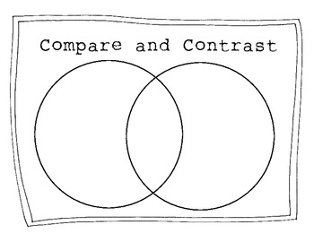
I can compare and contrast.

Slide 3
I can compare and contrast.

Slide 4
I can compare and contrast.
Explain how items are alike and different.
Write 4-5 comparative statements using specific details and examples from the text to support your position.
Use complete sentences.

Slide 5
I can determine cause and effect relationships

Slide 6
I can determine cause and effect relationships

Slide 7
I can determine cause and effect relationships

