Slide 1
Reader’s Workshop
ACRR- third Grade

Slide 2
Word Study Mini Lesson
I can
Examples | Non-Examples
Baseball Fireworks Together Football Railroad Skateboard Anybody Sometimes Upstream Sunflower | Alot Grateful Helpful Although
Notes:
Pre-

Slide 3
Word Work Activity
Work with a partner to generate a list of compound words.
You should find at least 20 words with your partner.
Create a chart to show the two separate words and after they have been joined together.
Create a word sort with your words by writing each part on a sheet of paper mix the words up.
Play a game of concentrations or matching with another group that is finished.
Word 1 | Word 2 | Compound Word
School | House | schoolhouse
Notes:
Pre-

Slide 4
Word Work
Word | Prefix | Prefix | Base or Root | Suffix | Meaning
With one partner, generate a list of 10 words. Separate each word by prefix, base/ root/suffix. Five of the 10 words must also have a suffix.
Create a Tic-Tac-Toe based on identifying each word by its meaning.
OR
Create a crossword puzzle with at least 5 clues across and 5 clues downward.

Slide 5
I can use mentor texts to improve my writing.
Mentor Text:
He dug until he made a hole.
How can you expand the sentence to make improvements?

Slide 6
I can identify and use nouns properly in my writing.
Definition | Characteristics
Examples | Non-examples
Nouns

Slide 7
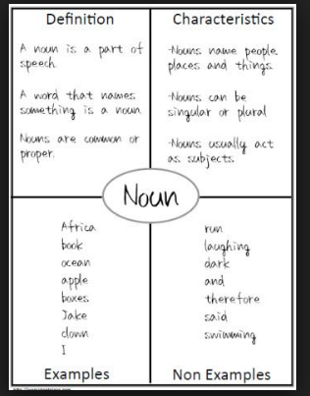
I can identify and use nouns properly in my writing.

Slide 8
Parts of Story
Character(s) | Setting (Location, Time, Place) | Plot Rising action, falling action, climax, resolution

Slide 9
Writer’s Workshop
ACRR- third Grade

Slide 10
Writing: Frayer Model
Reason 1: Indent 1st Paragraph Explain why the reason is valid Provide descriptive examples with proof that shows your reason is good. Use transition words to introduce new ideas. Combine related sentences with conjunctions | Reason 2: Indent New Paragraph Explain reason Provide descriptive examples Use transition words Combine related sentences
Reason 3: Indent New Paragraph Explain reason Provide descriptive examples Use transition words Combine related sentences with conjunctions | Conclusion: Last Paragraph Final Thoughts
.

Slide 11
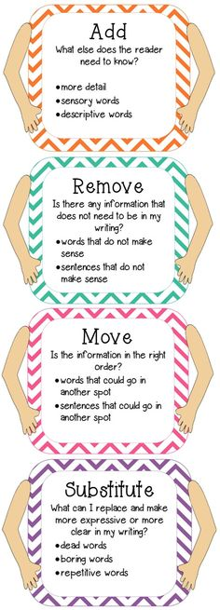
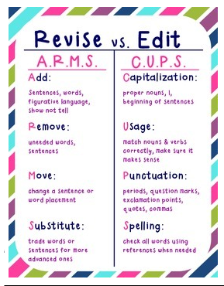
Notes:
Poster made by Michelle Lynch

Slide 12
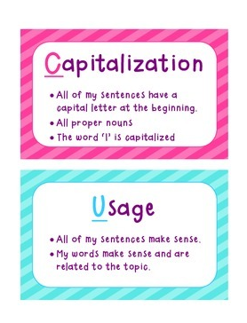
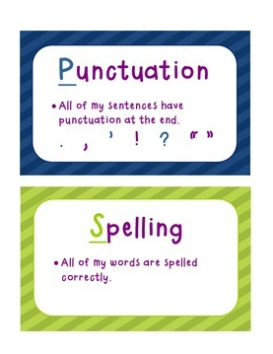
Notes:
Poster made by Michelle Lynch

Slide 13
Handwriting Practice: Due at 9:45

