Slide 1
Reader’s Workshop
ACRR- third Grade

Slide 2
Word Study Mini Lesson
I can
Examples | Non-Examples
Baseball Fireworks Together Football Railroad Skateboard Anybody Sometimes Upstream Sunflower | Alot Grateful Helpful Although
Notes:
Pre-

Slide 3
I can ask and answer questions about what I have read.
Character(s) | Setting (Location, Time, Place) | Plot Rising action, falling action, climax, resolution

Slide 4
Word Study Mini Lesson
I can
Examples | Non-Examples
Undecided Ungrateful Unavailable Unable Uncertain Uneven unpack | Upstream Unicorn Unicycle Umbrella Understand underneath
Notes:
Pre-

Slide 5
Word Study Mini Lesson
I can
Examples | Non-Examples
Recycle Reuse Reduce Redo Reapply Reassess Retake r | Render Residue Rain Rodeo reasonable
Notes:
Pre-

Slide 6
Word Work
Example | Non-example
Undecided | Unicorn Unicycle Umbrella
With one partner, generate a list of 10 words. Separate each word by prefix, base/ root/suffix. Five of the 10 words must also have a suffix.
Create a Tic-Tac-Toe based on identifying each word by its meaning.
OR
Create a crossword puzzle with at least 5 clues across and 5 clues downward.

Slide 7
Word Work
Word | Prefix | Base or Root | Suffix | Ending
With one partner, generate a list of 10 words. Separate each word by prefix, base/ root/suffix. Five of the 10 words must also have a suffix.
Create a Tic-Tac-Toe based on identifying each word by its meaning.
OR
Create a crossword puzzle with at least 5 clues across and 5 clues downward.

Slide 8
I can identify and use nouns properly in my writing.
Definition | Characteristics
Examples | Non-examples
Nouns

Slide 9
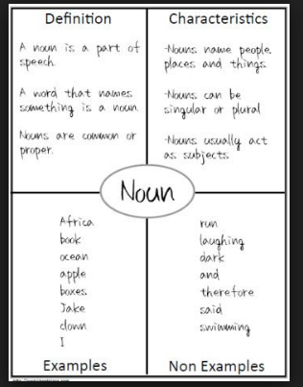
I can identify and use nouns properly in my writing.

Slide 10
Writer’s Workshop
ACRR- third Grade

Slide 11
What third-grade notebook writers…
Do… | Don’t…
Neat and organized Appropriate punctuation marks Take your time Words are spaced out legibly Proper grammar and word choice Descriptive, colorful words Lots of sentences Name, date & target goal In sequence or in order. Transition words- after, eventually, all of a sudden… Capital letters of beginning of sentence and proper nouns | Sloppy No loose papers More than one type of story No bad words No boring words Doodling/drawing Skip pages, jumping all over the pages

Slide 12
I can use mentor texts to improve my writing.
Record this into you Mentor Sentence Journal.
Mentor Text:
Then he poked again and clear spring water came spurting up in the hole. They were so pleased with it. They built a house of stones and they made a special door out of flat rock. Later, they balanced it in its place.
What observations have you made?

Slide 13
I can use mentor texts to improve my writing.
Record this into you Mentor Sentence Journal.
Mentor Text:
Then he poked again and clear spring water came spurting up in the hole. They were so pleased with it. They built a house of stones and they made a special door out of flat rock. Later, they balanced it in its place.
Invitation to identify parts of speech.

Slide 14
I can use mentor texts to improve my writing.
Record this into you Mentor Sentence Journal.
Mentor Text:
Then he poked again and clear spring water came spurting up in the hole. They were so pleased with it. They built a house of stones and they made a special door out of flat rock. Later, they balanced it in its place.
How can you expand the sentence to make improvements?

Slide 15
Writing Prompt
TG: I can write an piece that explains (narrates).
What do you do when you cannot think of something to write about?
Provide strong evidence to support your decision. Using reflective, colorful writing to paint a vivid picture. This is a serious topic. Careful thought should be given before you begin writing.

Slide 16
Handwriting Practice:

